Slide 1

ECOMMERCE
JS-FRONT

Slide 2



START
MON NOV 28th
END
FRI DEC 2ND Midnight
PRESENTATION
MON DEC 5th
DESIGN
CODE
END
JURY

Slide 3

WHAT WE EXPECT
Choose the features to code, and decide in which order you will code them.
Code your E-Commerce site
Present your site

Slide 4

WHAT YOU CANNOT DO:
Copy paste from friends
we will check the similarities between code
Code from internet if you don’t understand it
you may be asked to explain your code

Slide 5
HOW WILL WE EVALUATE ?
YOUR
PROJECT
YOUR
PRESENTATION
70%
30%

Slide 6

WHAT
IS
ECOMMERCE

Slide 7
FEATURES
DESCRIPTIONS

Slide 8











Site-Wide Features
RED Tickets are MANDATORY.
You must do all RED tasks.
Seller Features
MENU BAR
10
CLEAN CODE
15
CREATE PRODUCT
15
DISPLAY PRODUCTS
10
BLUE Tickets are OPTIONS.
Do at least 60 pts of BLUE tasks.
Customer Features
VALIDATE INPUT
15
NICE LAYOUT
10
REMOVE PRODUCT
10
UPDATE PRODUCT
15
DISPLAY PRODUCTS
(CUSTOMER)
10
SEARCH PRODUCT
15
??????
PRODUCT RATINGS
15
SORT PRODUCT
10
DISPLAY PRODUCT DETAILS
10
SHOW CART
10
CHECK-
OUT
15
VALIDATE CREDIT CARD
10

Slide 9
MARKING SCHEME EXAMPLE
You must make at least 60 points worth of tickets in extra items, plus the 60 mandatory tickets.
Some tickets have dependencies on others. Think carefully what they are when choosing tickets!
You lose points if you didn’t make the dependency (e.g. ‘checkout’ needs ‘add to cart’)
Ticket | Points Available | Judge’s opinion | Score
Create product | 15 | Minor non-fatal bugs | 12
Display Products | 10 | Good | 10
Menu Bar | 10 | No menu bar! | 0
Remove Product | 10 | Remove Button is on screen, but function doesn’t do anything | 2
Clean Code | 15 | Good naming and spelling, but files not divided sensibly | 10
Compulsory Items Total | 60 |  | 35
Search Product | 15 | Good | 15
Validate Input | 15 | Incorrect validation, breaks page | 3
Product Ratings | 15 | Ratings are stored correctly, but output is sometimes wrong | 11
Update Product | 15 | Page looks ok, but update stores the wrong data due to bug | 7
Extra Items Total | 60 |  | 36
Notes:
Dependencies are e.g. you need “Add to Basket” before you can make “View Basket”.

Slide 10
MARKING SCHEME EXAMPLE
EXTRA TICKETS: There are no extra marks for tickets above 60 points, BUT, judges use only the points from the best scoring tickets - so it may be worth doing extra to be safe!
Ticket | Points Available | Judge’s opinion | Score
Create product | 15 | Minor non-fatal bugs | 12
Display Products | 10 | Good | 10
Menu Bar | 10 | No menu bar! | 0
Remove Product | 10 | Remove Button is on screen, but function doesn’t do anything | 2
Clean Code | 15 | Good naming and spelling, but files not divided sensibly | 10
Mandatory Items Total | 60 |  | 35
Search Product | 15 | Good, but can’t search on partial matches | 12
Display Products | 10 | Excellent | 10
Product Ratings | 15 | Ratings are stored correctly, but output is sometimes wrong | 11
Checkout | 15 (5) | Missing most fields, not showing total price | 3 (1)
Validate Input | 15 | Good but missed the date checks | 11
Sort Product | 10 | Didn’t do Ascending/Descending or Sort by Price | 5
Extra Items Total | 60 |  | 45
Team made 80 points of tickets total.
Worst scores of 20 points of tickets are removed.
Notes:
If removing the worst tickets doesn’t give an exact result of 60, we pro-rata the scores. e.g. if the team makes 70 points, and the worst ticket is 15 points, we calculate it as a 5 point ticket by multiplying its score by 5/15ths.

Slide 11
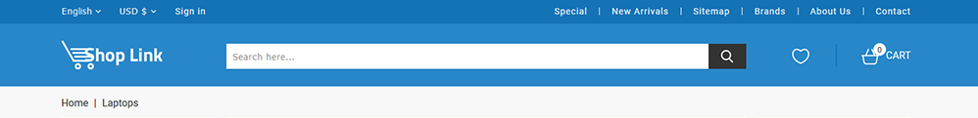
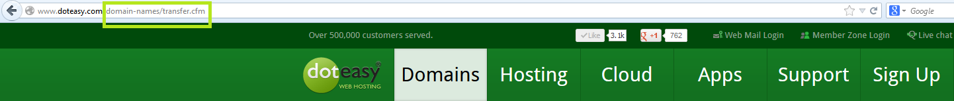
F1: SITE-WIDE / MANDATORY
MENU BAR

Slide 12
F2: SITE-WIDE / MANDATORY
CLEAN CODE
Features divided sensibly between files?
Spelling in variable, functions and filenames? Consistent naming?
Do the variable and function names help the judges understand what the code is doing?
Useful commenting?
Avoid bad coding practices in the recommended code guidelines?
Variables declared and used only in the scope they’re needed?
e.g. unnecessary global variables, loop variables declared before the loop for no reason, etc
Constant variables defined as const?
Spacing, indentation etc?
End javascript lines with semicolons?
JS will work without semicolons, but it makes it safer against bugs.
Notes:
The judges will be reading lots of code to assess these projects - so, if you make your code easy to understand, you will make the judges happy!

Slide 13
F3: SITE-WIDE / OPTION
VALIDATE INPUT
Check that input fields are valid inputs
Do this for all pages with inputs!
Name:
is this filled in? is it too long or too short?
Description:
is this filled in?
Price:
is this a valid number? is it a positive number? is it a realistic number?
Currency:
is this one of the currencies we support?
Image:
is this a URL?
This example is for the ‘add product’ page. We also need to validate inputs on any other forms on our site - e.g. ‘update product’, ‘search’ etc.

Slide 14
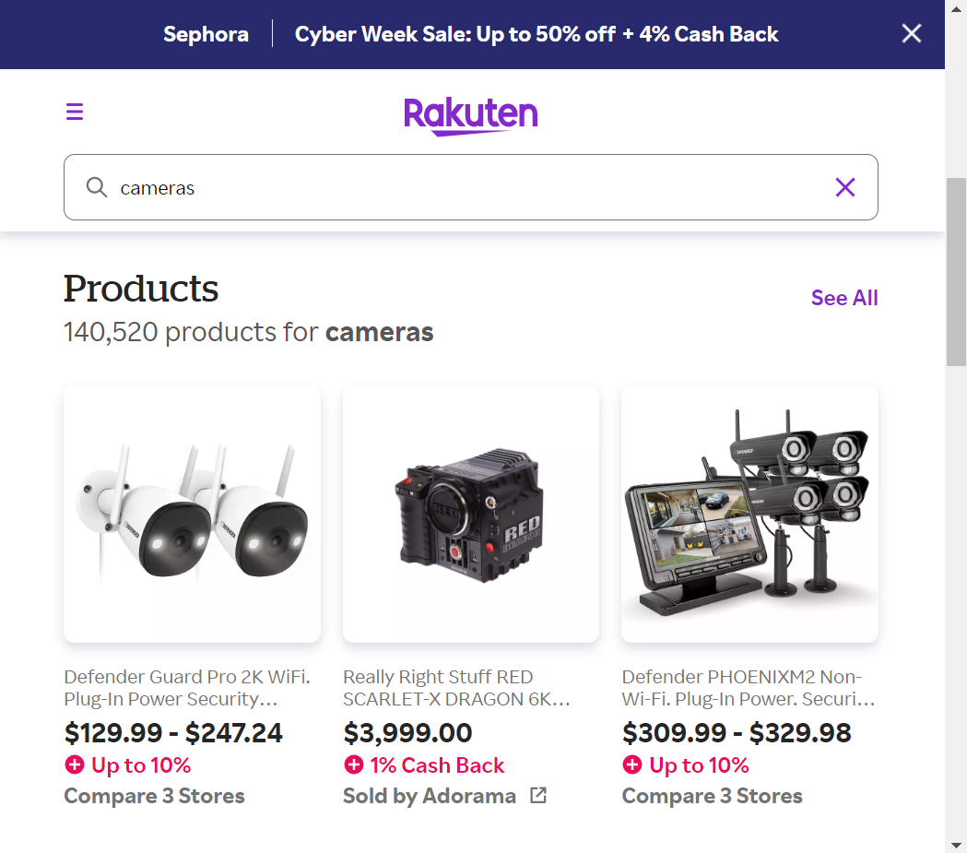
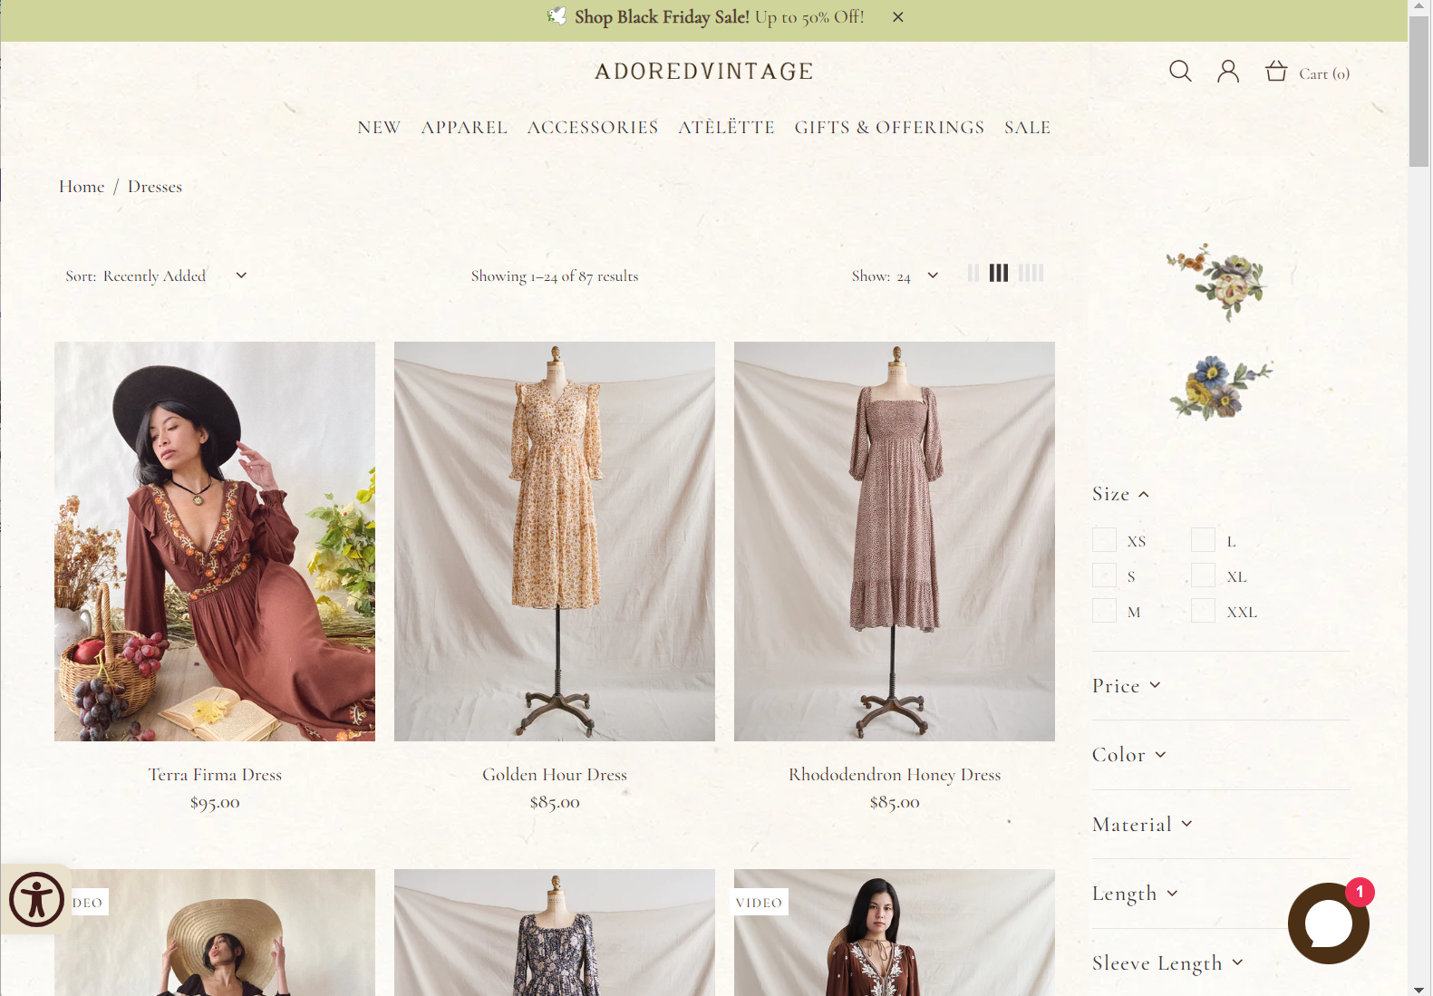
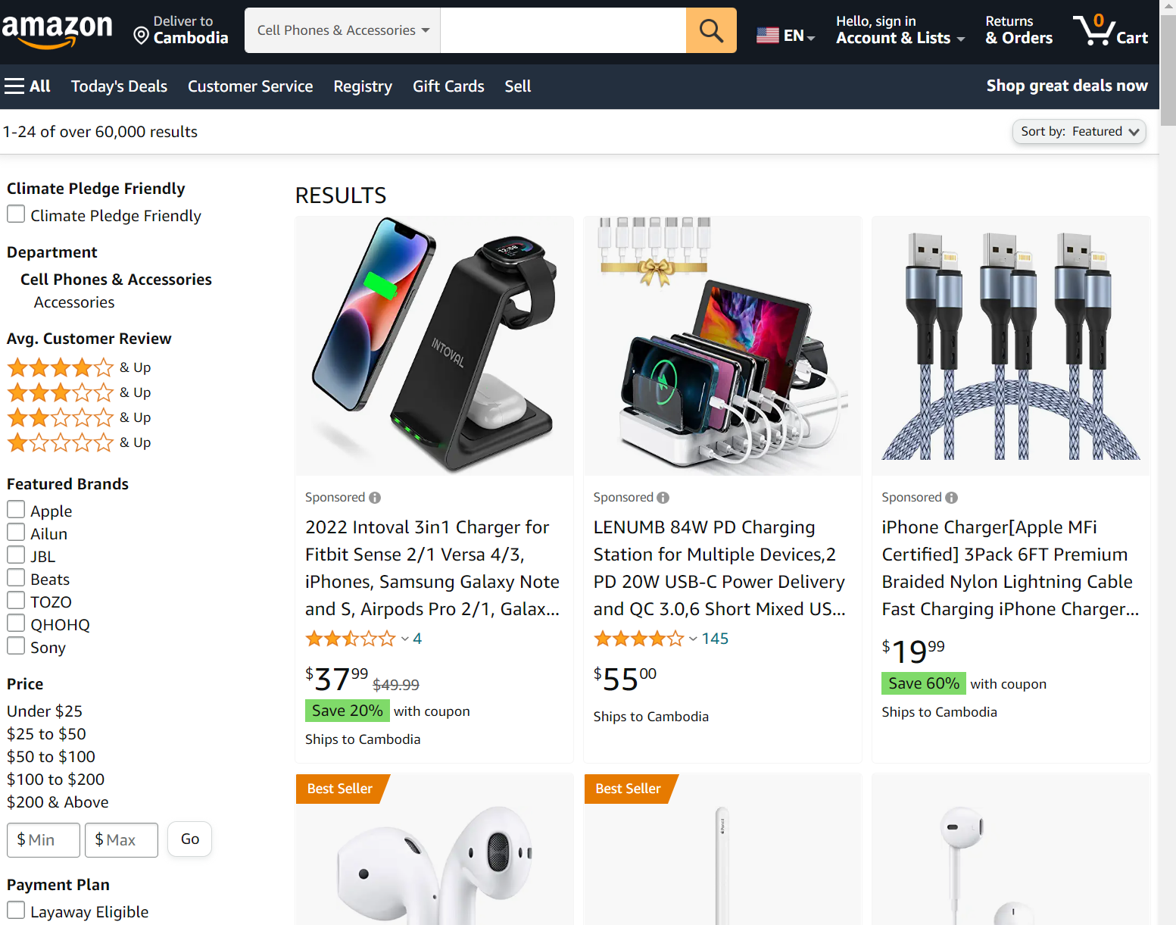
F4: SITE-WIDE / OPTION NICE LAYOUT
CSS styling - alignment - font choice - good colour scheme -
correct English - nice images - easy to use - etc

Slide 15
F5: SELLER / MANDATORY
CREATE PRODUCT
Form to add a product in the list of products
Store results in Local Storage
Use Local Storage for this project. In a real-world ecommerce site, we would store it in a database instead
Name:
Description:
Some fields must be required!
Price:
Currency:
Image:
Think carefully about how to handle currency. Is there a difference between how we store it and how we display it?
Bonus: if we automatically add a Unique Identifier (UID) to each product, we can have more than one product with the same name
SAVE

Slide 16

F6: SELLER / MANDATORY
List the products in a grid
Show only buttons for seller, e.g.
Edit product
Delete product
Add product
DISPLAY PRODUCTS
(SELLER)
UID | Name | Description | Price | Actions
1 | V-Neck T-Shirt | Red | 50,000៛
2 | Hoodie | Red, long sleeves | $40
3 | Hoodie | Blue, smiley face | £45
Add Product

Slide 17
F7: SELLER / MANDATORY
REMOVE A PRODUCT
Delete a product
UID | Name | Description | Price
1 | V-Neck T-Shirt | Red | 50,000៛
2 | Hoodie | Red, long sleeves | $40
3 | Hoodie | Blue, smiley face | £45

Slide 18
F8: SELLER / OPTION UPDATE PRODUCT
Form to update a product chosen from the list of products
Name:
Old name
Description:
Old name
Price:
Old price
How does the seller choose which product to update?
Currency:
Old currency
Image:
Old image URL
UPDATE
Notes:
Ca c’est la feature de recherche plutôt Le filtre serait un filtre sur les propriétés

Slide 19
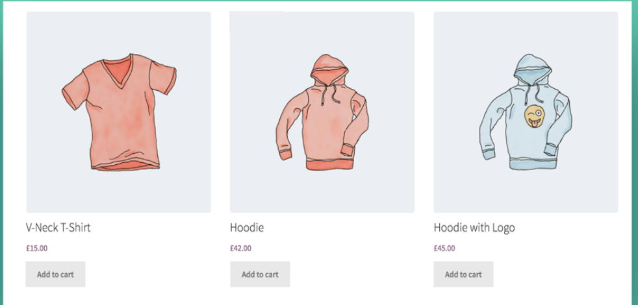
F9: CUSTOMER / OPTION
DISPLAY PRODUCTS
(CUSTOMER)
List the products in a grid
Show only buttons for customer, e.g.
Add to cart
View product

Slide 20
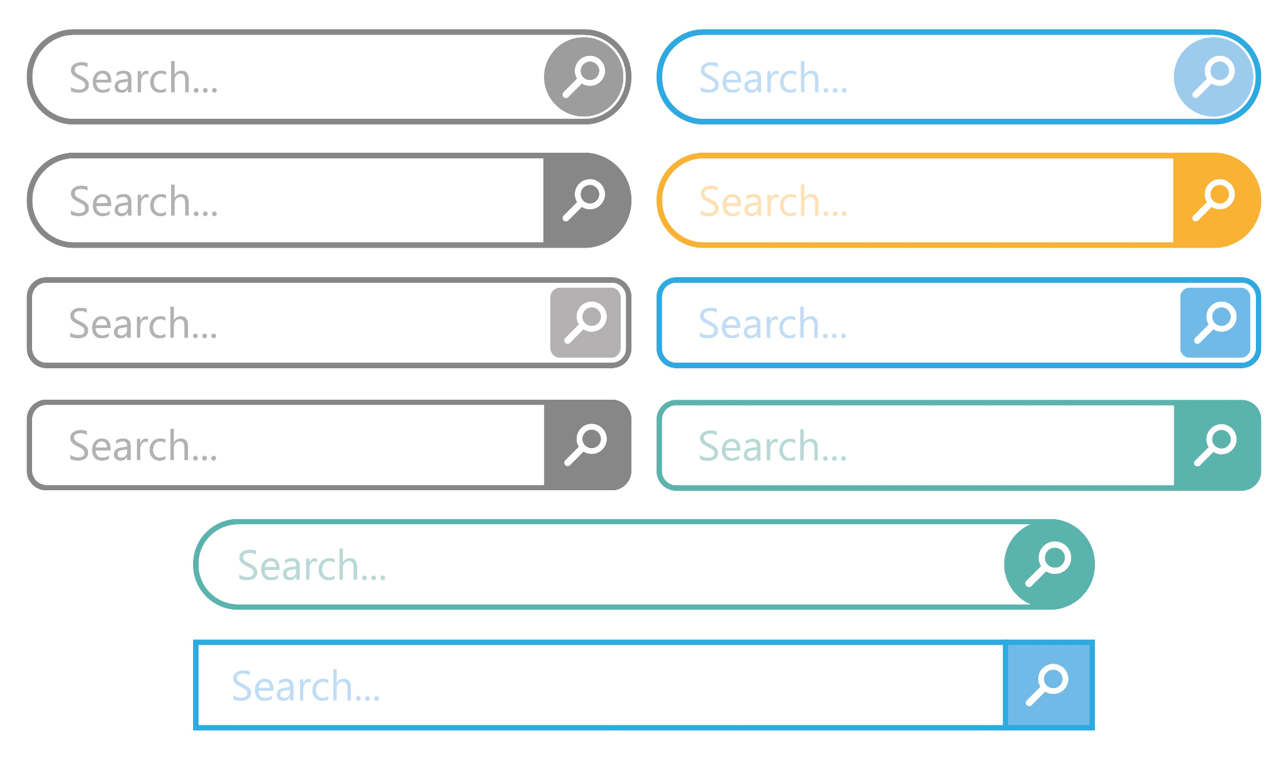
F10: CUSTOMER / OPTION
SEARCH PRODUCT
Think about:
How to find all products that match the search
What fields to search on (e.g. name, description, price?)
How to display them on screen
What order to display on screen

Slide 21
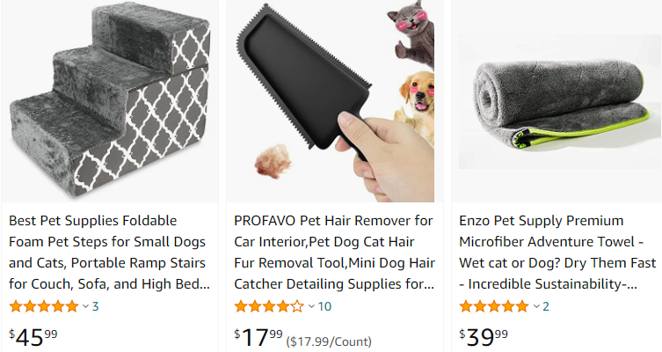
F11: CUSTOMER / OPTION
PRODUCT RATINGS
Think about:
How to set the rating
How to calculate the rating
Average of all ratings?
How to save the rating
How to load the rating
How to display the rating
Rating
Notes:
Ca c’est la feature de recherche plutôt Le filtre serait un filtre sur les propriétés

Slide 22
F12: CUSTOMER / OPTION
SORT PRODUCT BY CATEGORY
For all result pages (customer and seller):
Sort by Name
Sort by Price
Ascending / Descending (cheapest first, most expensive first)
What else could we do?
Sort by New?
Sort by Rating?
Sort by Relevance?
Be sure to sort price as a number,
not as a string!
Watch out for currency too!
Notes:
Remember, if you sort price as a string, then [‘2’,’3’,’200’] is sorted as [‘2’,’200’,’3’].

Slide 23
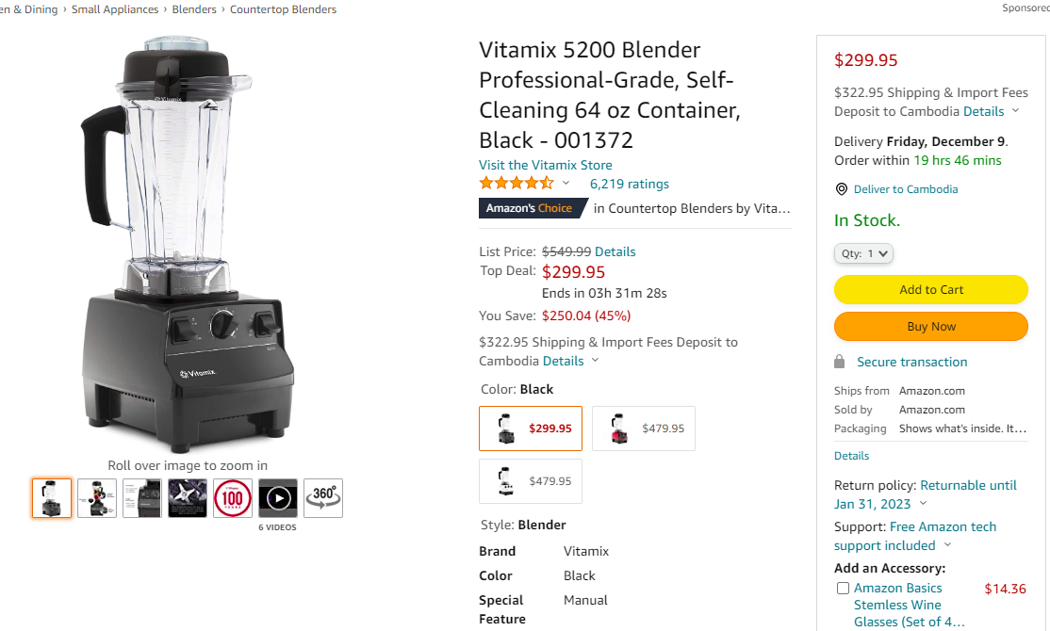
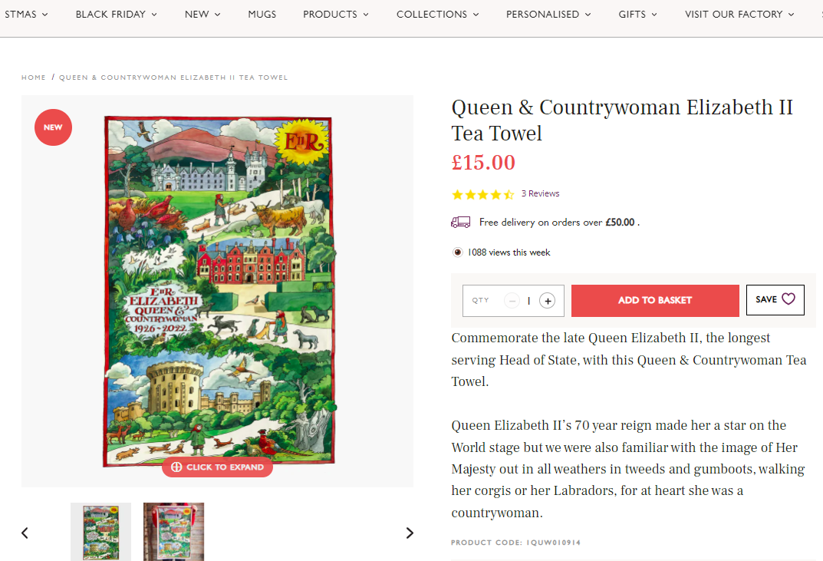
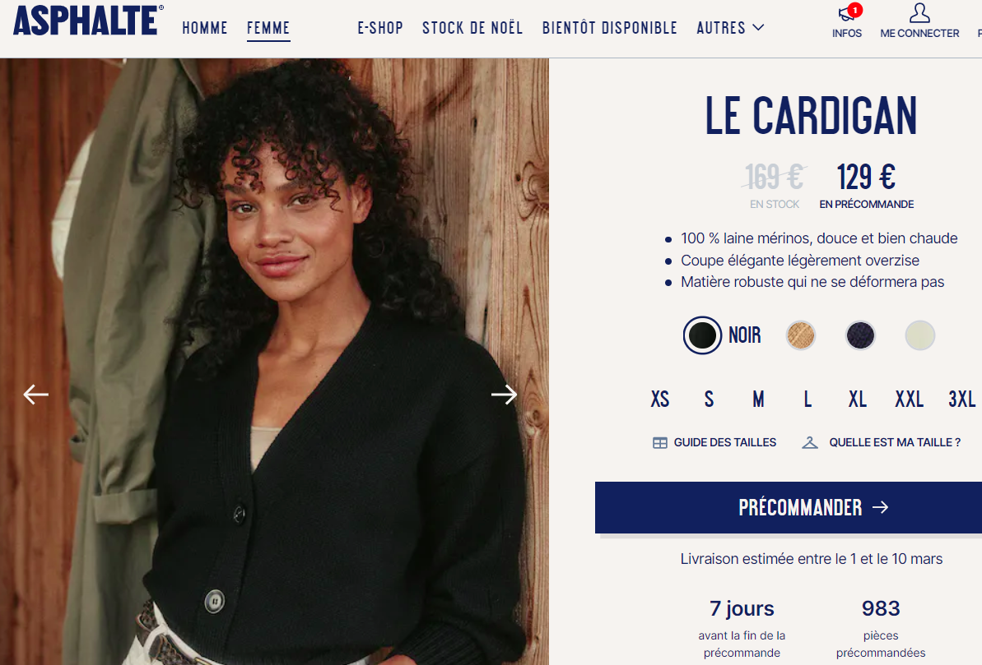
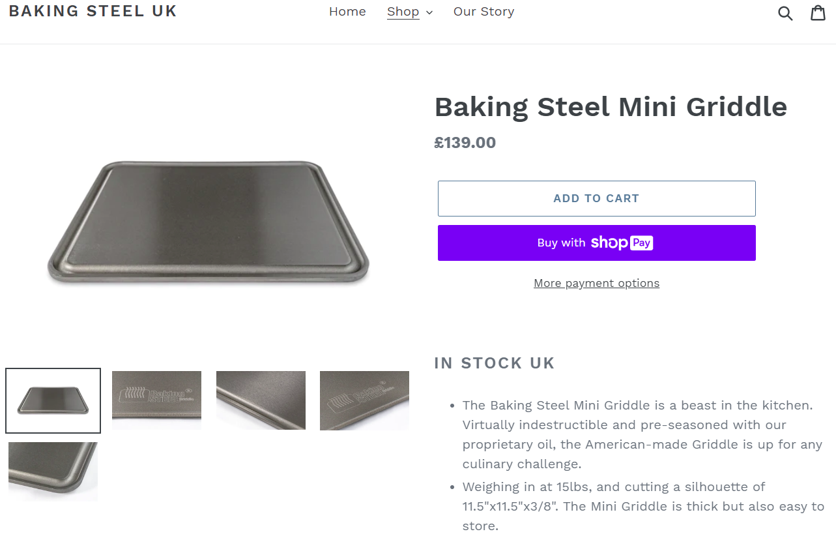
F13: CUSTOMER / OPTION
DISPLAY PRODUCT DETAILS
Display image, price, description
Anything else?
availability (in stock)?
product rating?
‘add to cart’ button?
Link back to customer’s previous page

Slide 24
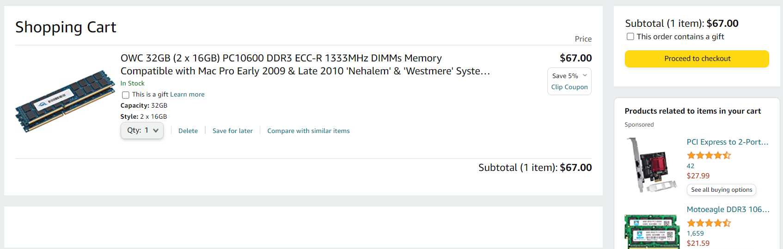
F14: CUSTOMER / OPTION
SHOW CART (BASKET)
Add to Cart
“Add to Cart” buttons on other pages
Store contents of cart
Display contents of cart
Display total price of cart
Link to Checkout page

Slide 25
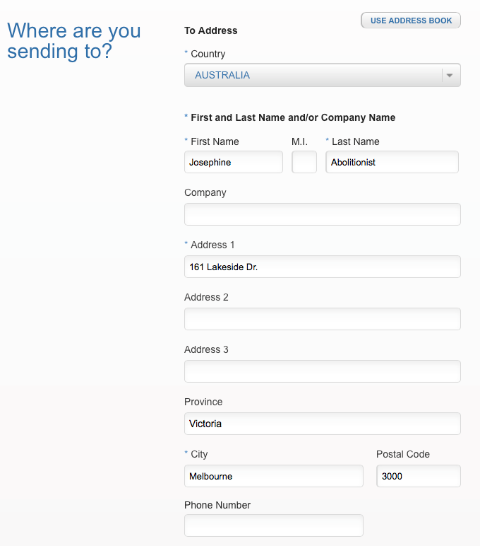
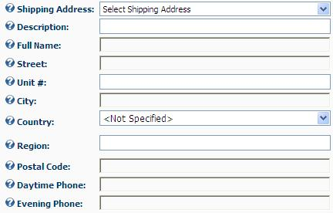
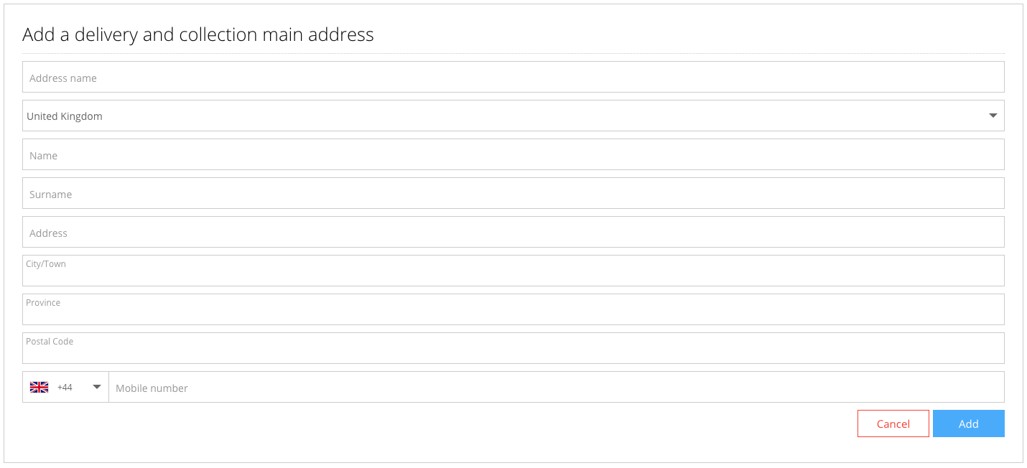
F15: CUSTOMER / OPTION
CHECKOUT
Display total price
Take customers delivery address and credit card
This is the step after Show Cart!

Slide 26
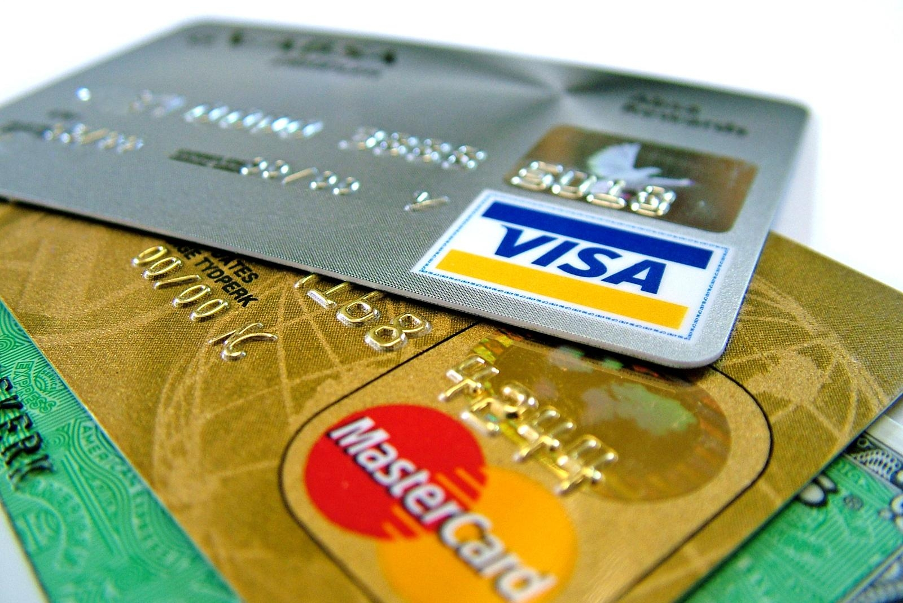
F16: CUSTOMER / OPTION
VALIDATE CREDIT CARD INPUT
Validate - are the start and end dates of the card within range?
Research: what is a credit card checksum or “check digit”?
show an error if the number is not valid
Can we identify and display the type of credit card (e.g. Visa, American Express, Mastercard) from only its number?
What other fields need validation?
For this project, the above is enough.
But in your future jobs, remember there are more rules about processing credit card numbers.
Search “PCI Compliance” for details.

Slide 27

TASK ESTIMATION
How long do you think it will take to do each ticket?
Estimating Tasks will be important in your job!
Understand the task
Break down the task into subtasks
e.g. Divide ‘ratings’:
Create local storage for rating
Make button to add rating
Make onClick() function
Calculate new rating
Show rating
Estimate each subtask
Add estimates together
If you estimate all the tickets before choosing,
it will help you find which ones will get you
the easiest points!
TEAM ESTIMATION METHOD
Write your estimates in secret
on some paper
on your phone, or,
use a site like https://planningpokeronline.com/
Everyone reveal their estimates at the same time
Whoever gave the highest estimate explains why
Whoever gave the lowest estimate explains why
Go to Step 1 and vote again, and repeat until the group agrees on an estimate (or the numbers stop changing)

Slide 28

TEST PLANNING
Planning tests is a great way to check understanding of the requirements before you write code!
How can you be sure your code works?
Make a TEST PLAN in Excel, Word, Notepad or other
Test Name | Description | Expected output | Test Date | Pass / Fail?
Add to Cart, simple case | Click ‘Add to Cart’, check using Console if data has been added | Item should be in ‘cart’ array, with correct details | 1/12 | PASS
Add to Cart, repeat | Click ‘Add to Cart’ twice, check using Console if data has been added | There should be two items in ‘cart’ array | 1/12 | PASS
Add to Cart local storage | Add item to cart. Press ‘refresh’. Check Console. | Item should still be in ‘cart’ array | 1/12 | FAIL
…etc | …etc | …etc

